Slide 1


For Beginner
By :- RAHUL JOGRANA
www.dotnetlab.in
www.aspnetinhindi.blogspot.com
Twitter:- @thejograna
Github:- github.com/rahuljograna
Part 11 inputs in ionic

Slide 2

Inputs in ionic
Inputs are essential for collecting and handling user input in a secure way. They should follow styling and interaction guidelines for each platform, so that they are intuitive for users to interact with. Ionic uses Angular 2’s form library, which can be thought of as two dependent pieces, Controls, and Control Groups.
Each input field in a form has a Control, a function that binds to the value in the field, and performs validation. A Control Group is a collection of Controls. Control Groups handle form submission, and provide a high level API that can be used to determine whether the entire form is valid.

Slide 3
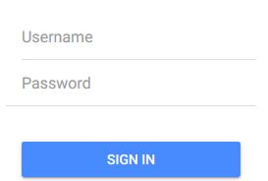
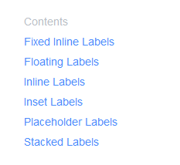
Inputs in ionic

Slide 4
Let’s start

Slide 5
To learn new Technology along with Example like
ASP.NET, ASP.NET MVC, AngularJS, ASP.NET Web API
From Beginners visit my Youtube channel and steps and Source code is
Available on My Blog and Web site
To Get notification for new updates Subscribe my YOUTUBE Channel.
Source Code :- http://aspnetinhindi.blogspot.com
Website :- http://www.dotnetlab.in
Github :- https://github.com/rahuljograna
Twitter :- twitter.com/thejograna
Mail :- rahuljograna007@gmail.com
WhatsApp Number :- 9426585554

Slide 6
To Develop Application
Contact me
Mail me : rahuljograna007@gmail.com
Mobile : +91 9426585554
whatsApp : +91 9426585554

